Slide 1


Predictive
Analytics with DSC
Group 6
Marcelo Ramirez | Timothy Hollinger | Shruti Bajpai

Slide 2
Project
Scope
Table
Of
Contents
I
III
Analysis
Evaluation
&
Conclusion
II
Methodology
IV

Slide 3
Product Scope
Assessment of Direct Mail Campaigns
Finding the Target Donor Profile
Find the Campaign Profitability
Create a Model to Increase Donor Response
Evaluate Model Effectiveness

Slide 4
Methodology

Slide 5





The Predictive Analytics Proccess
1
STEP
STEP
3
STEP
5
Creation of Data Warehouse
Data Cleansing
& Analysis
Predictive Model
2
STEP
4
STEP
Filtering for Respective Campaigns
Modeling of Train and Test Datasets

Slide 6
Analysis

Slide 7
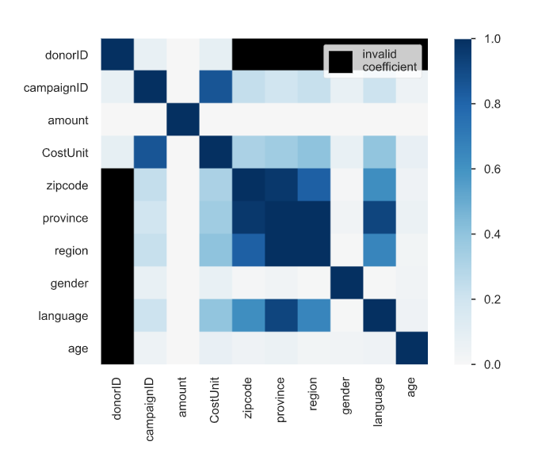
Phik (φk)
Moderate Correlation shown between Cost Unit and several categorical variables.
Donation amounts & age provide little correlation
Notes:
Phik (φk) is a new and practical correlation coefficient that works consistently between categorical, ordinal and interval variables, captures non-linear dependency and reverts to the Pearson correlation coefficient in case of a bivariate normal input distribution. There is extensive documentation available

Slide 8
Historical Donor Analysis
Top Five Donors Based on Donation Value
Donation by Frequency and Recency displayed different donors.
Donor ID | Recency | Frequency | Monetary Value
123168 | 3805 | 2 | € 4,000,030.00
120861 | 4404 | 1 | € 2,479,000.00
122679 | 3275 | 4 | € 30,120.00
105960 | 377 | 120 | € 13,830.37
109635 | 3906 | 7 | € 13,718.40

Slide 9

Target Donor’s Profile
Age: 45-60
Gender: Male
Language: Dutch
Region: Flanders
Country: Belgium
*Note: Information based on all historical data to compare with Campaign 6169
*Note II: Job, Income, Marital Status are details not provided

Slide 10
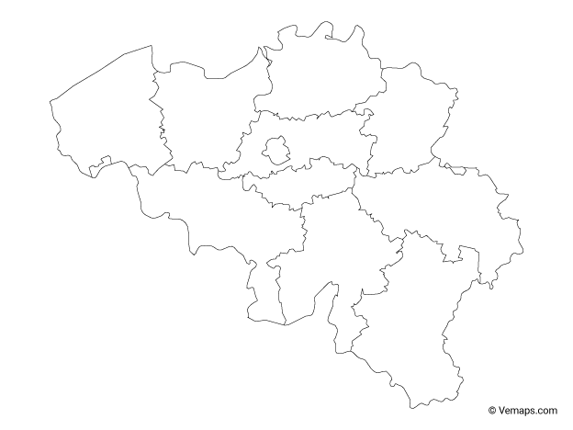
Target Donor’s Profile
Antwerp
East Flanders
West Flanders

Slide 11
Evaluation & Conclusion

Slide 12
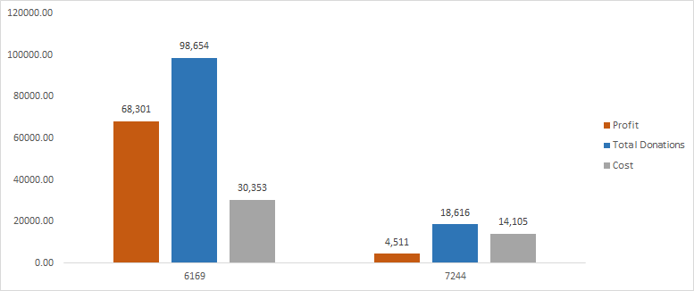
Campaign Cost Evaluation
Campaign 6169 and 7244 were successful

Slide 13
Model Evaluation & Predictions
Feature Selection
Model Evaluation
Model | AUC Train | AUC Test
Nearest Neighbors | 0.92 | 0.95
Language: Dutch
Age: ≥ 50
Province:
East Flanders
West Flanders
Antwerp
Gender: Male
60% of Data Needed for 2.1x Response Rate
Campaign 7662 Donor Prediction
12,512 Potential Donors
Target Donors:
Donor 105960
Donor 108658
Donor 120499

Slide 14
Recommendation
Gather Additional Donor Information
Evaluate Metrics that Identify Successful Campaigns
Review Effectiveness of Mail as Campaign Methodology
Explore Additional Mediums to Reach Target Donor at Reduced Cost
Evaluate the Model's Effect on Profitability for the Campaign
Notes:
Evaluate Metrics that Identify Successful Campaigns – evaluate cost of sending mail and effectiveness of mail donors. The campaign costs have to be reviewed and also the promotion strategies.

Slide 15
Back-Up Slides

Slide 16
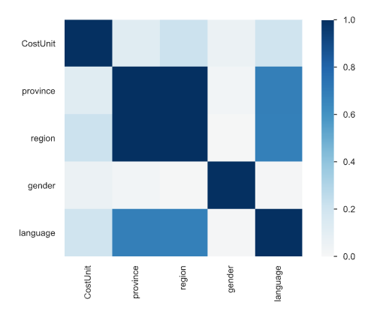
Cramér's V (φc)
Moderate Correlation:
Region & Cost Unit
Language & Cost Unit
Province & Cost Unit
Low Correlation:
Gender & Cost Unit
Notes:
Cramer’s V is based on conducting the Chi-squared test which tests the correlation between two categorical variables.
Cramér's V is an association measure for nominal random variables. The coefficient ranges from 0 to 1, with 0 indicating independence and 1 indicating perfect association. The empirical estimators used for Cramér's V have been proved to be biased, even for large samples

Slide 17
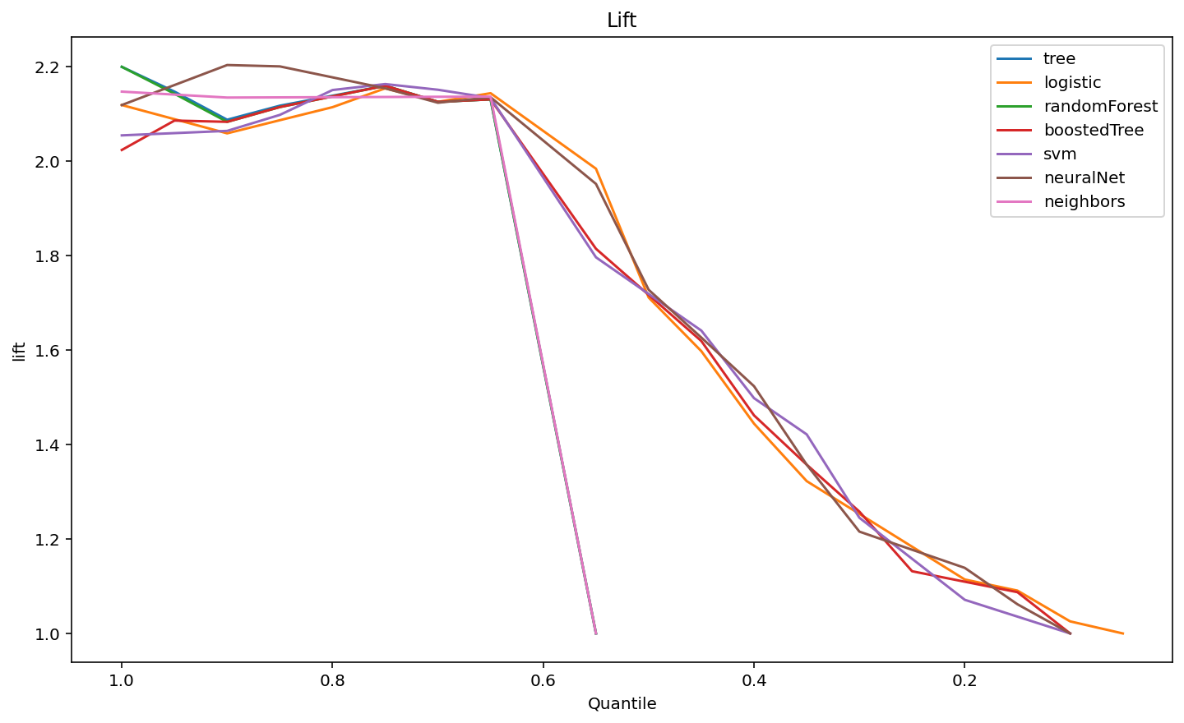
Model Lift
Maximum Lift of 2.2x Possible increase

Slide 18
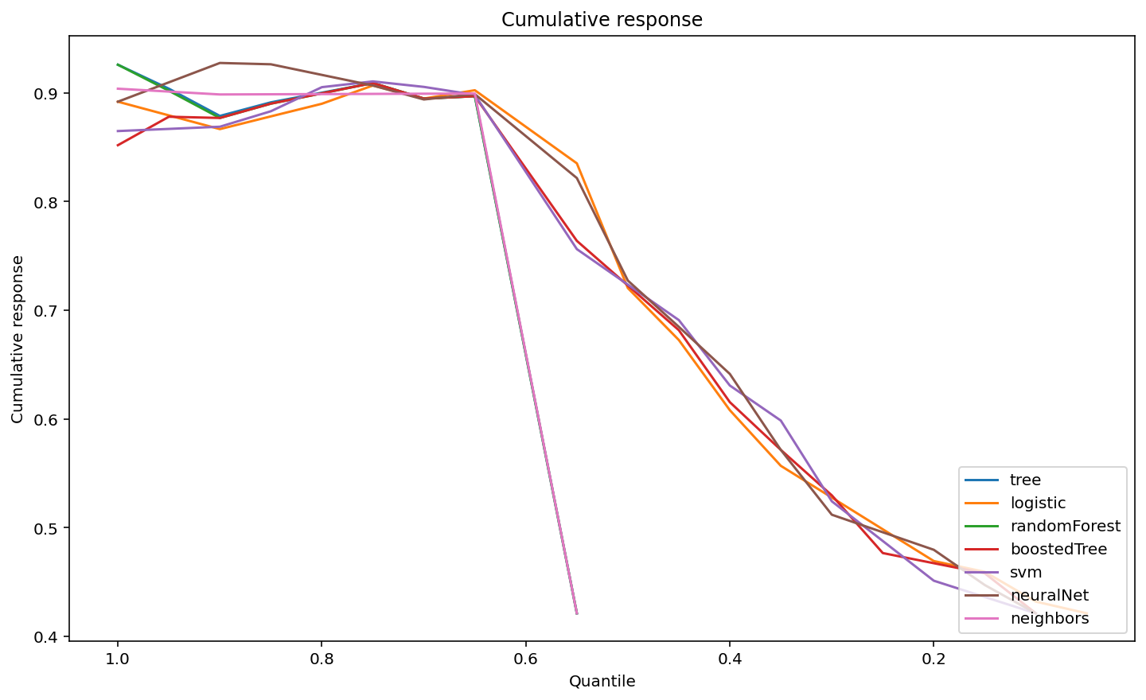
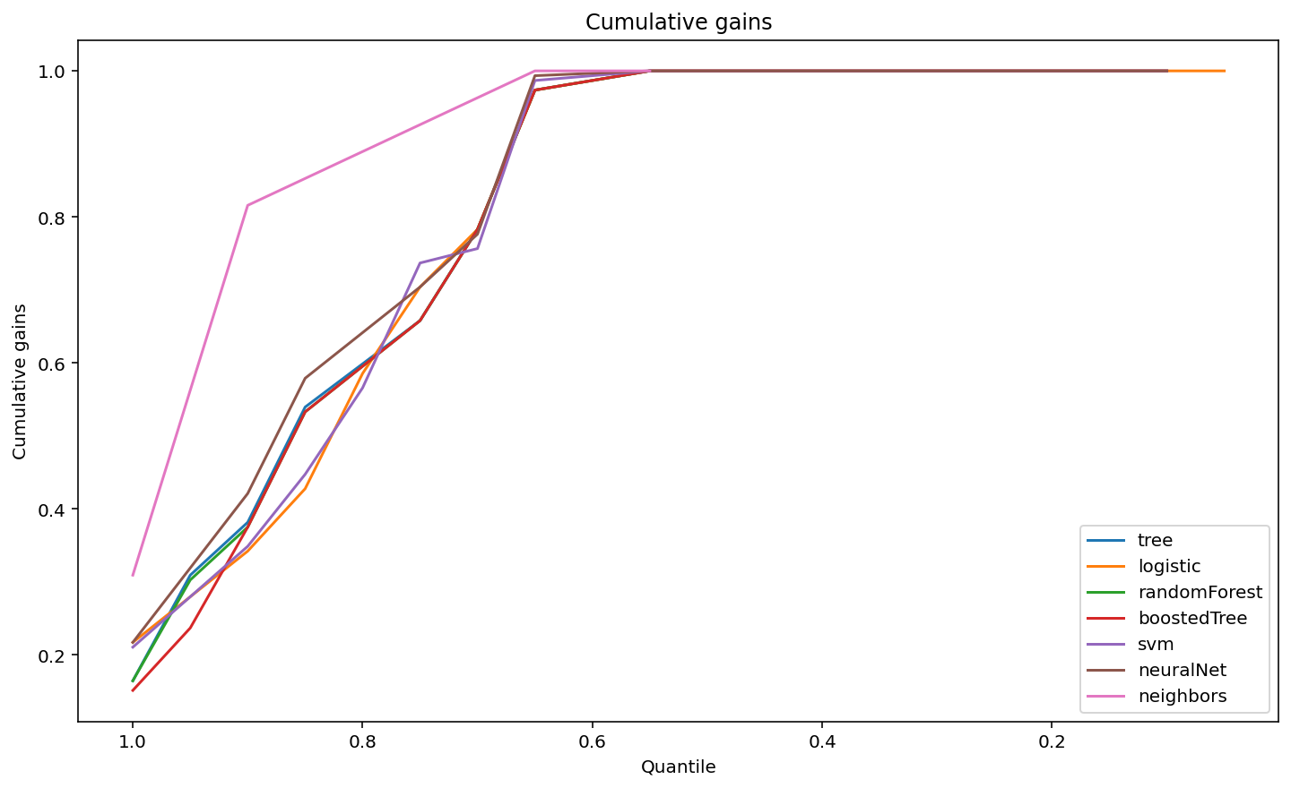
Predictive Analytics Analysis
Cumulative Gains
Cumulative Response
60% of Data Needed for 2.1% Response Rate
Provides Better Performance with Boosted Tree Model

